Slide 1
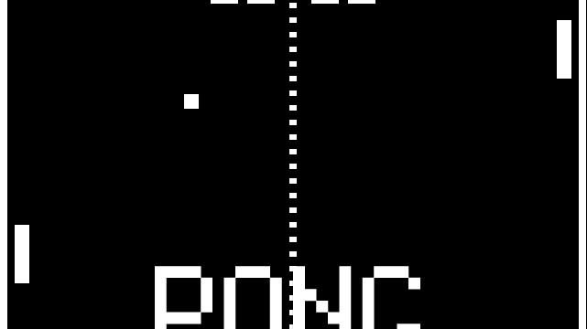
Game Development
Tiago Belmonte

Slide 2

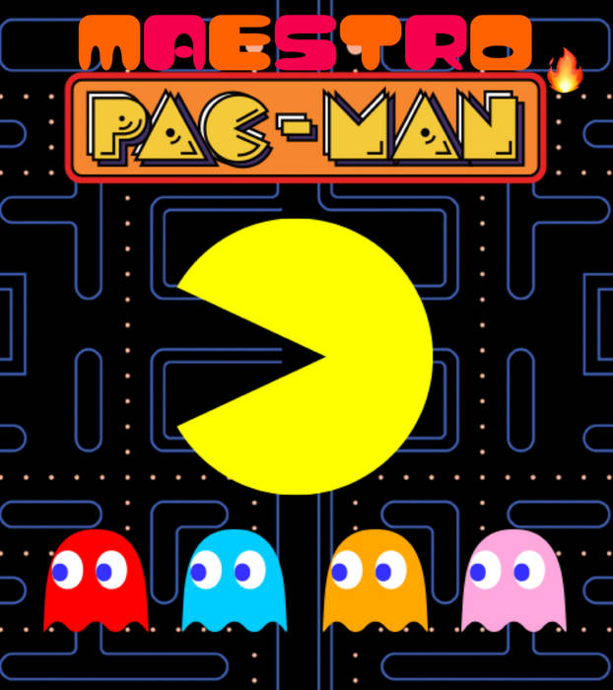
Wat hebben
Pac-Man en GTAV gemeen?

Slide 3

Stages of game development
Planning
Pre-production
Production
Testing
Pre-launch
Launch
Post-launch

Slide 4
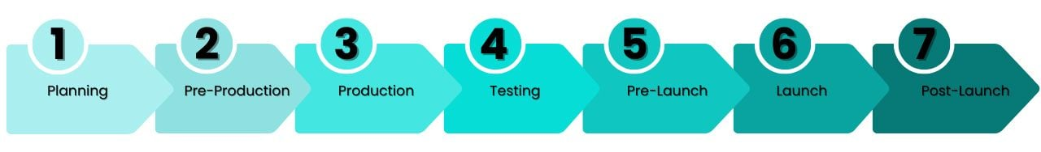




Slide 5
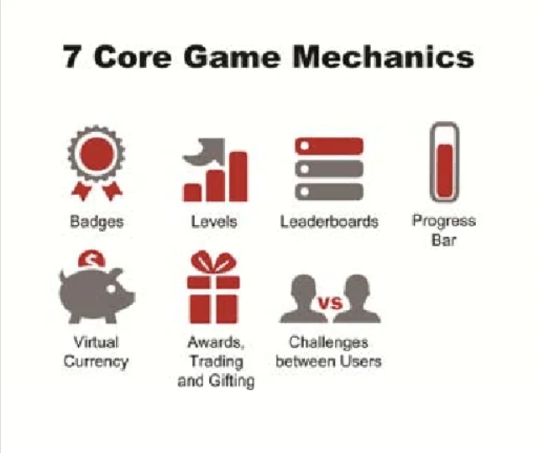
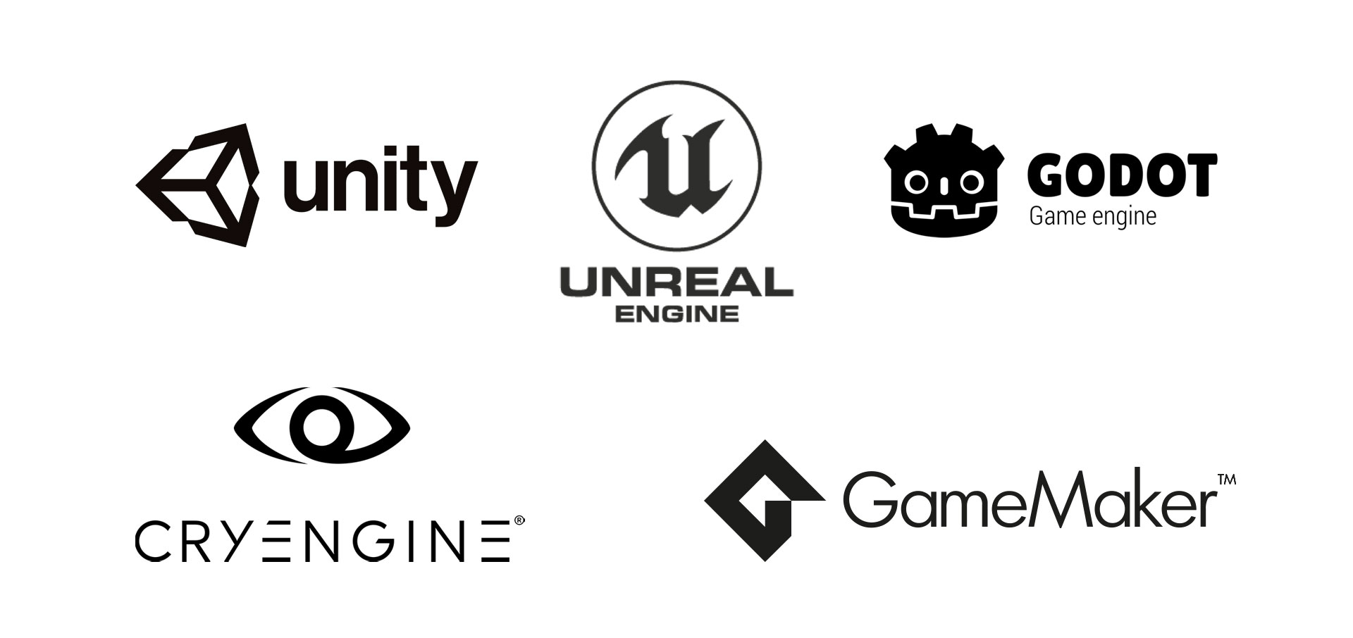
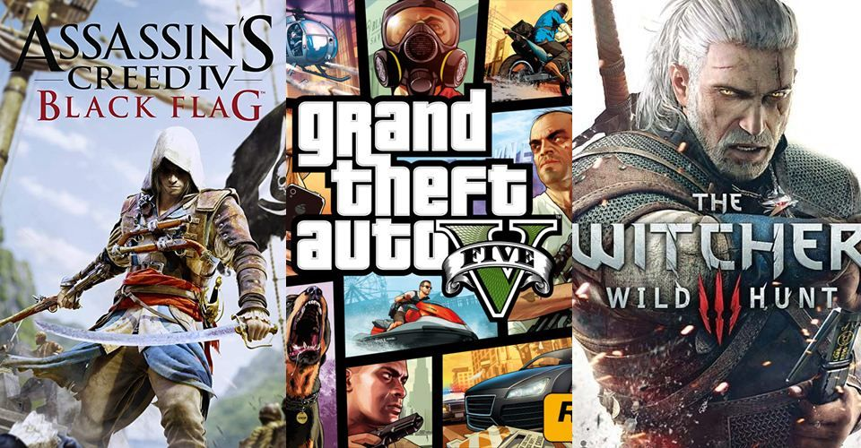
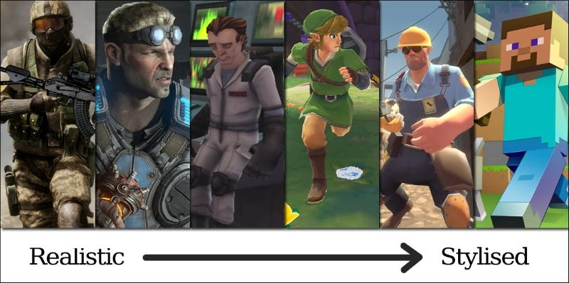
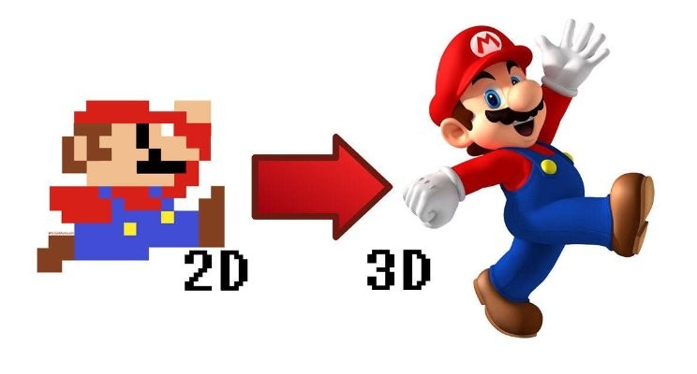
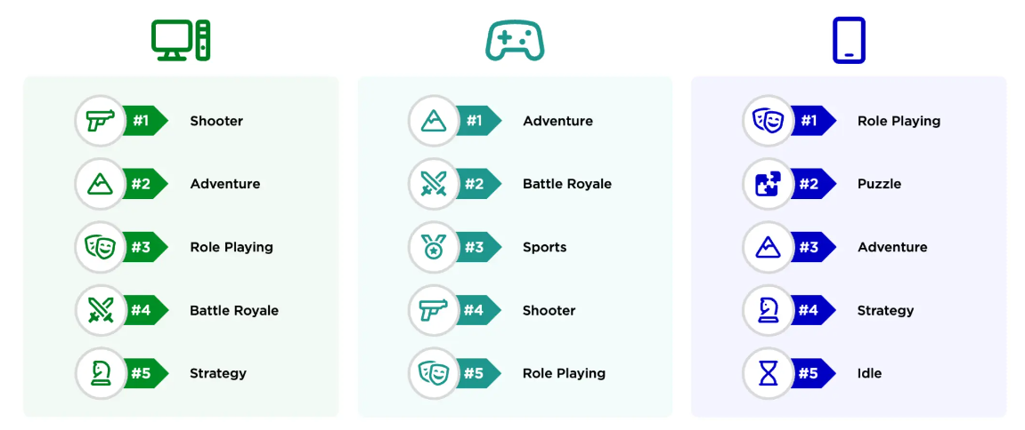
Genre?
2D of 3D?
Style?
Mechanics?
Story?
Game engine?

Slide 6
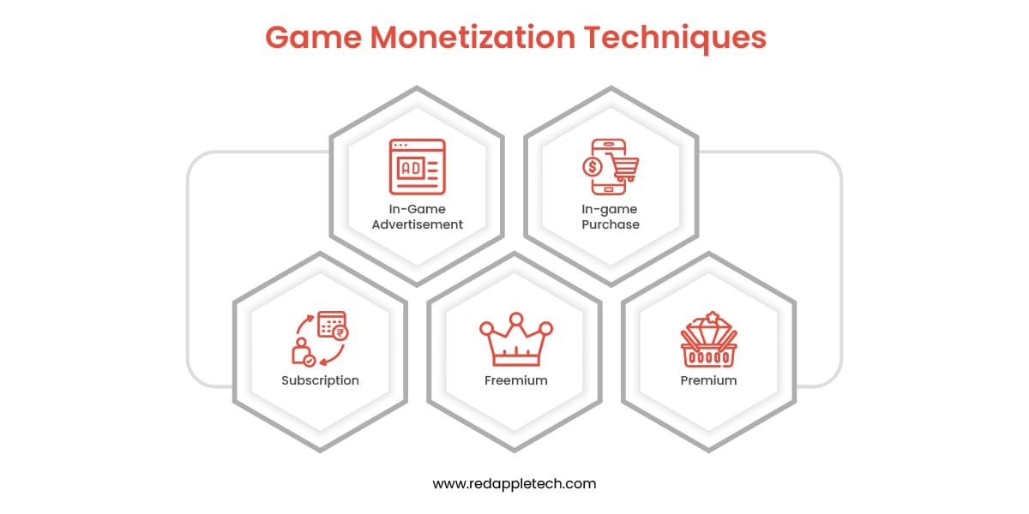
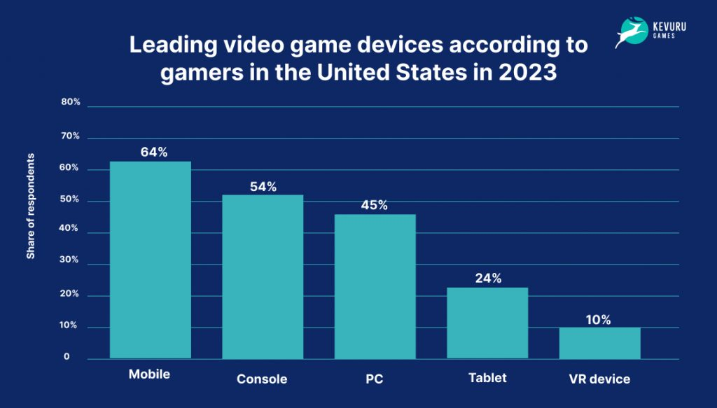


Proof of Concept
$$$
Sponsors?
Alleen of team?
Monetiseren?
Platform?

Slide 7

Artists
Developers
Project leader
Writers

Slide 8
Developers & designers
NPC
Voice actors
Sound designers
Writers

Slide 9



Technologie
Systeemarchitectuur
Coderen
AI
UI
Optimalisatie
Debugging

Slide 10

Solid environments
Performance issues
Exploits
Softlocks
Difficulty
Scripting and acting errors
Fun factor

Slide 11



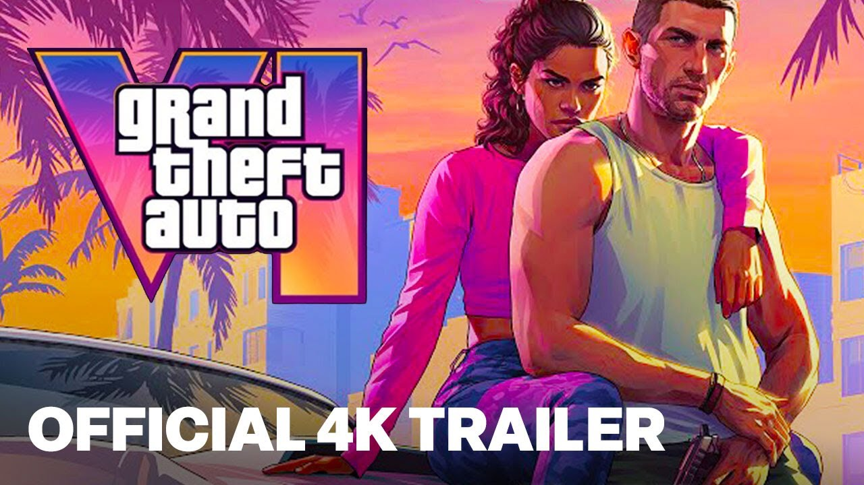
Trailer
Demo’s
Early Access
Events
criticism

Slide 12
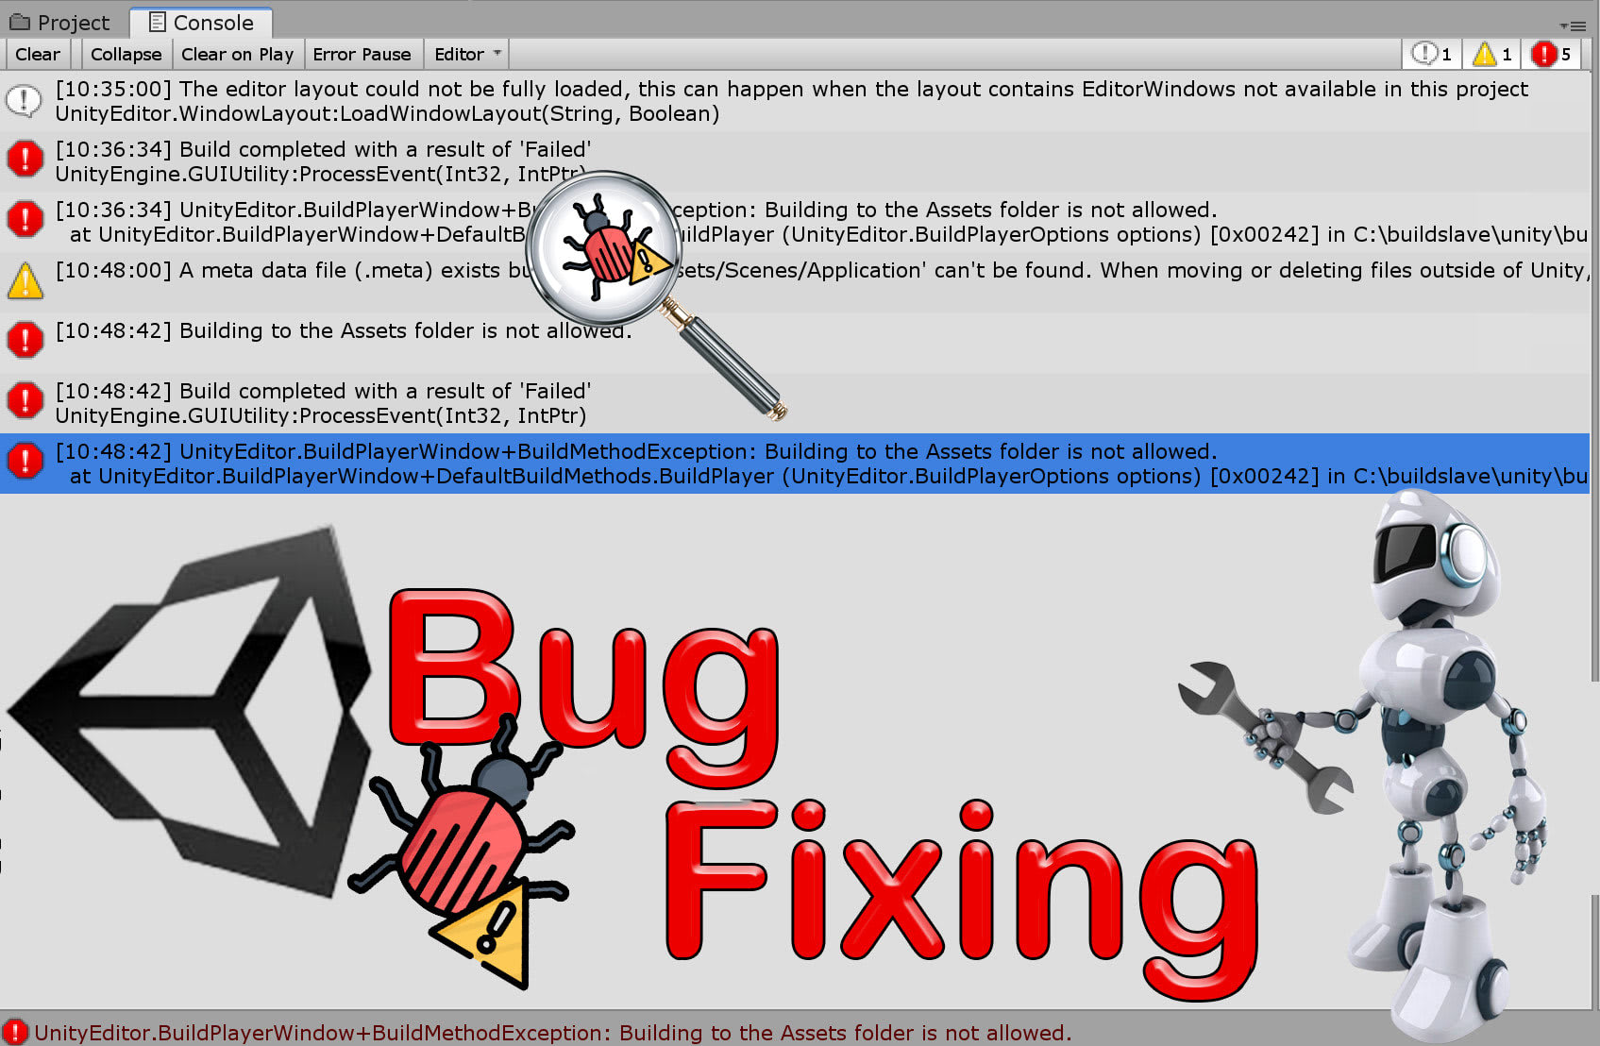
Bugs
Implement
Final artistic

Slide 13

Bedankt

Slide 14
Kan door muren lopen
Spel al uitgespeeld
Spel is saai na level 50
Ik zou graag meerdere winkels willen openen
Niet genoeg producten

Slide 15
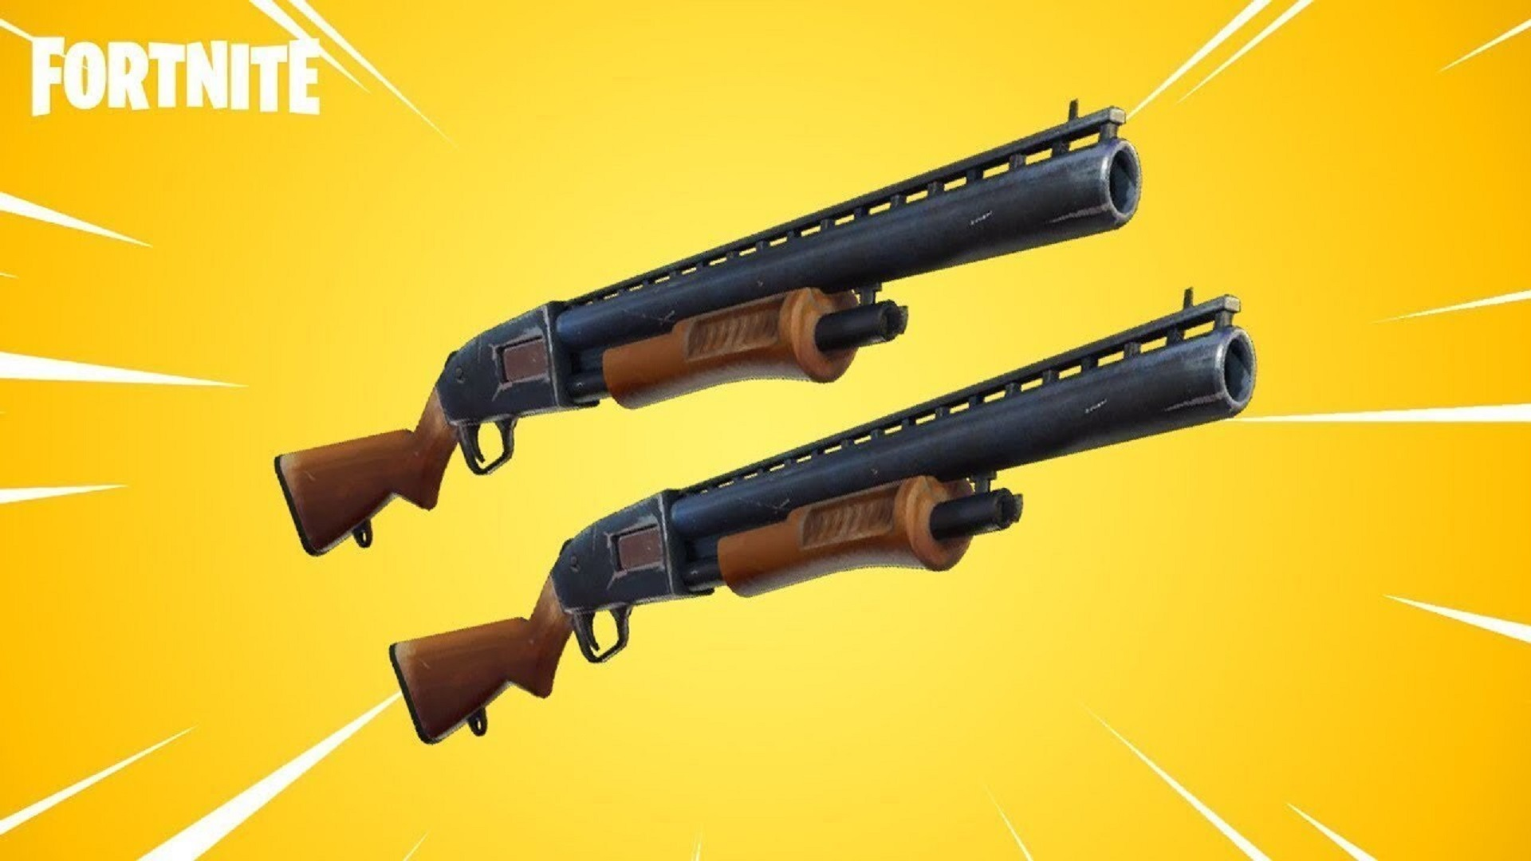
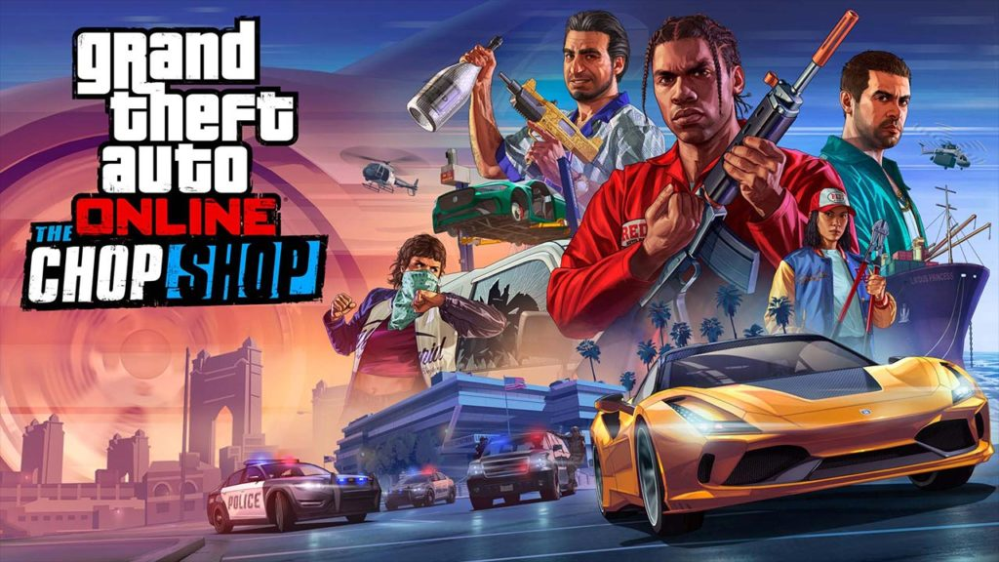
Bug fixes
DLC
FREE
Game-balancing patches

Slide 16
Bedankt
Tiago Belmonte

